Slide 1
Digital Citizenship
Lecture by Hallur ÖRn Jonsson

Slide 2
A short history TImeline...
1965: Two computers at MIT in Boston communicate with each other for the first time in history.
1987: The number of internet hosts reaches 20.000.
1990: HTML language is created and a year later the WorldWideWeb is created.
1993: The number of computers connected to the Internet reaches 2.000.000. In 1985 it was 2.000.
1994: Amazon.com is launched.
1995: The first dating site is created
1996: The first viral videos surface.

Slide 3
Ok maybe not so short
1998: Google is founded.
2004: Facebook goes online thus starting social networking.
2005: Youtube is launched.
2007: The Iphone comes onto the market and dramatically changes how we interact with the world.
2010: Facebook reaches 400 million active users. Instagram is launched.
2011: Twitter and Facebook play a big part in revolutions in the Middle-East.
2016: Donald Trump is elected president of the USA to a large degree due to the internet and social media.

Slide 4
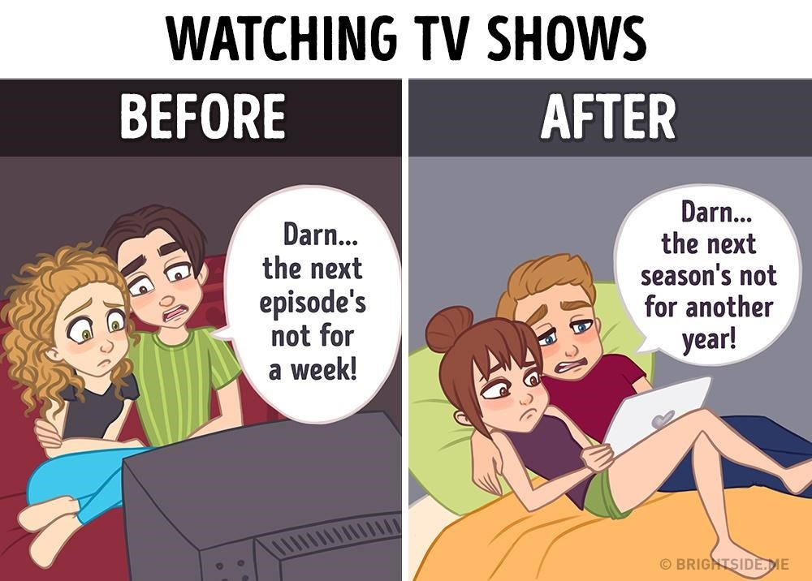
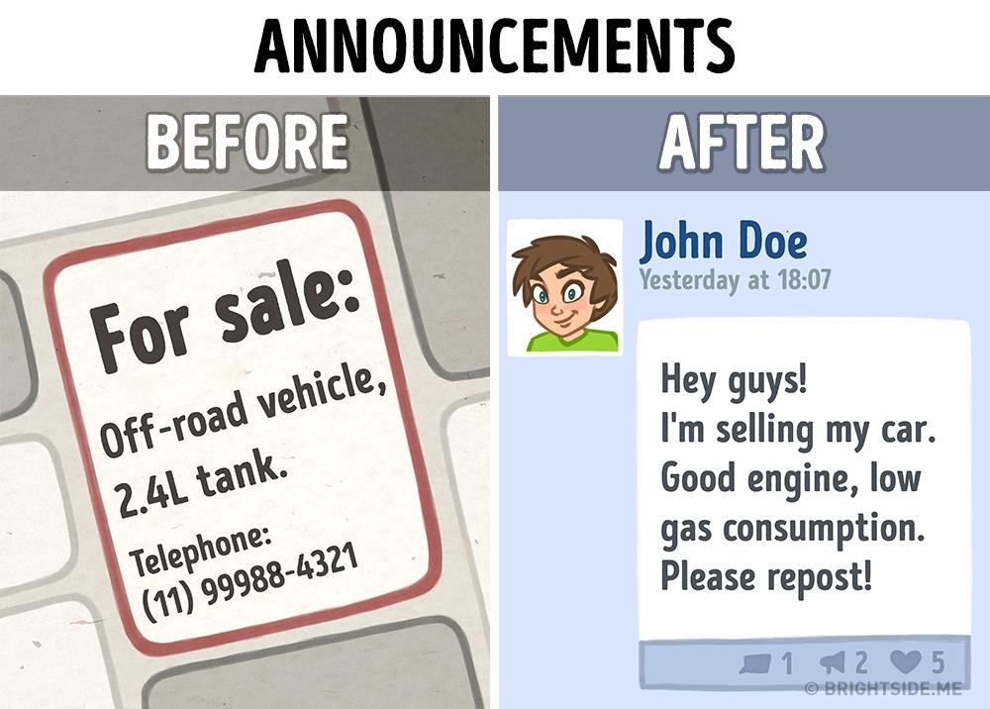
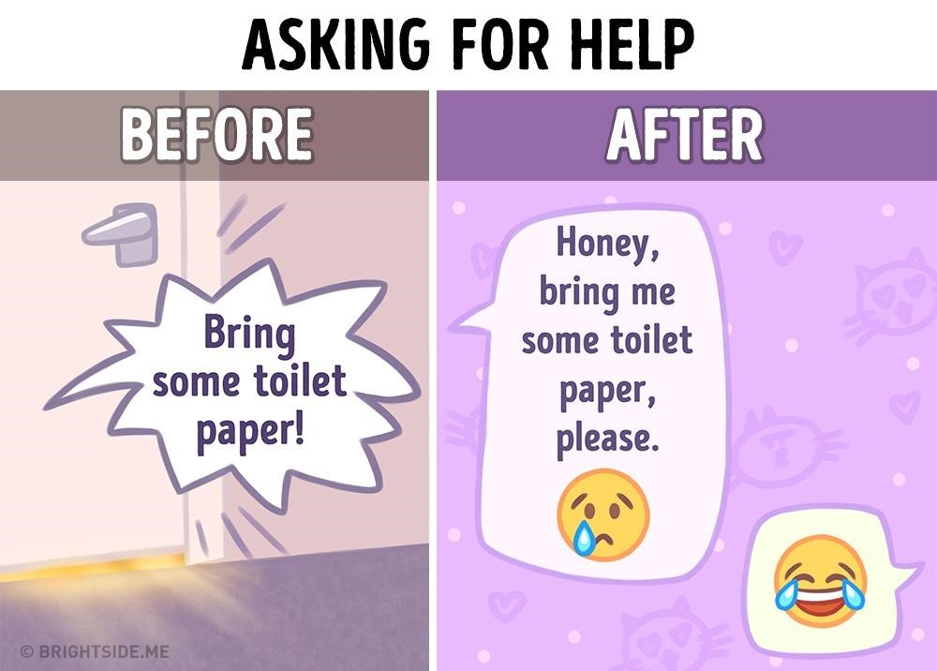
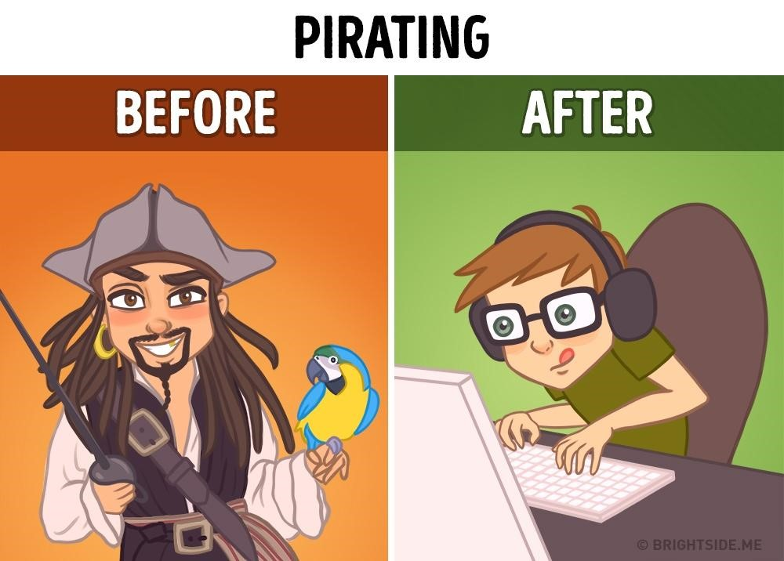
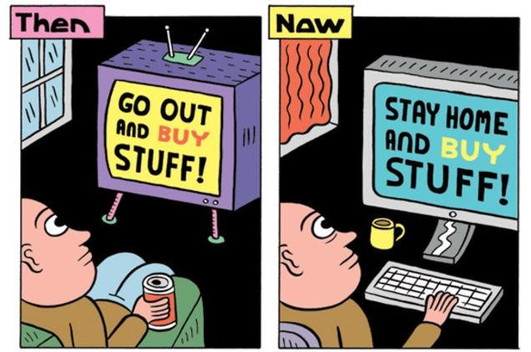
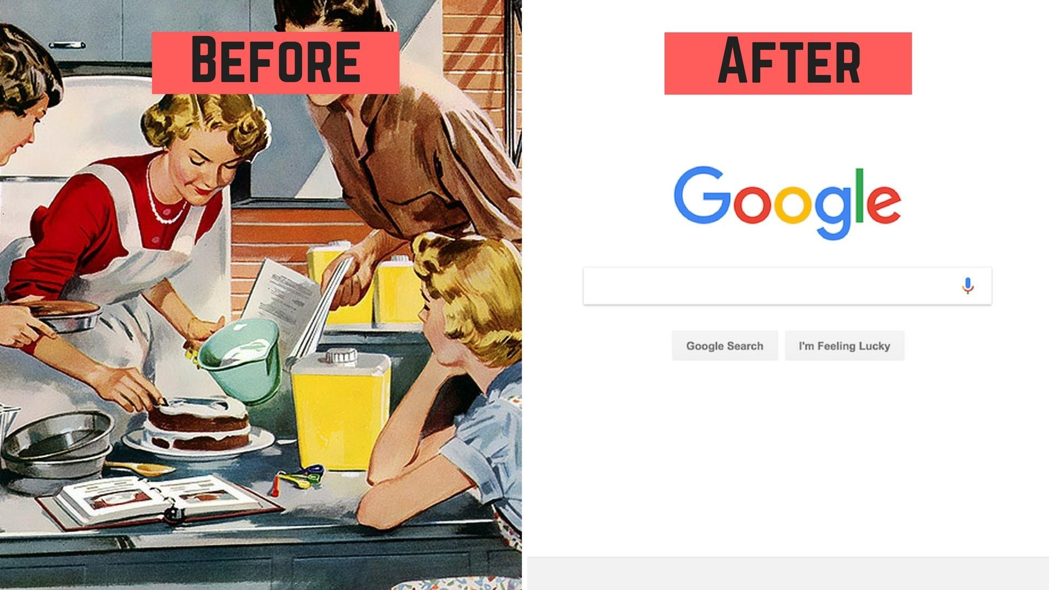
https://blogs.systweak.com/2018/01/before-and-after-internet-how-things-changed/

Slide 5
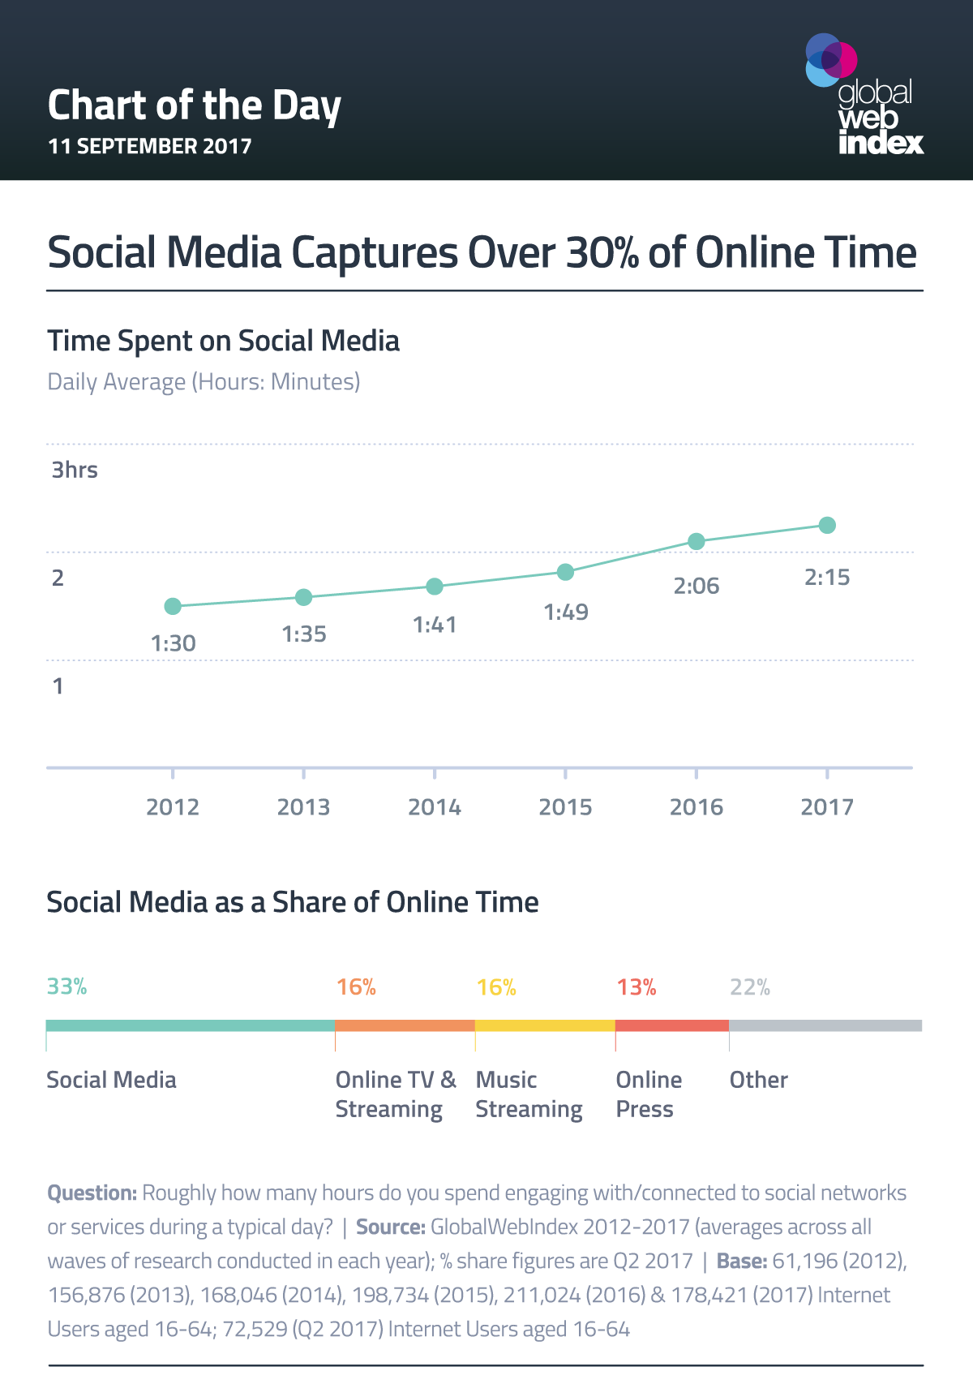
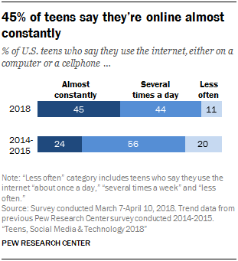
Statistics on Social Media Usage

Slide 6
The Internet and News

Slide 7
So the key lesson here is that...
... with the launch of the WorldWideWeb and all subsequent inventions such as social media ...
...our lives have changed ...
... a lot!!
And certain skills are required of us all to navigate through this digital world that we now find ourselves in.

Slide 8
DefinitIons of 3 Key Terms
Digital Citizenship:
Digital citizenship is the norms of appropriate, responsible technology use.
DigitalCitizenship.net
Digital Citizen:
A person who develops the skills and knowledge to effectively use the Internet and other digital technology, especially in order to participate responsibly in social and civic activities.
Dictionary.com
Digital Footprint:
Evidence of a person’s use of the Internet. This includes anything that can be linked to his or her existence, presence, or identity.
Dictionary.com

Slide 9
The 9 elements of Digital Citizenship
Digital Access: full electronic participation in society
Digital Commerce: electronic buying and selling of goods.
Digital Communication: electronic exchange of information.
Digital Literacy: process of teaching and learning about technology and the use of technology.
Digital Etiquette: electronic standards of conduct or procedure.
Digital Law: electronic responsibility for actions and deeds.
Digital Rights & Responsibilities: those freedoms extended to everyone in a digital world.
Digital Health & Wellness: physical and psychological well-being in a digital technology world.
Digital Security (self-protection): electronic precautions to guarantee safety.
DigitalCitizenship.net
Notes:
Digital Access:
The most fundamental block to being a digital citizen.
Socio-economic status, location and other disabilities can restrict or close off internet access. (Not a problem in Iceland – more in the developing world).
This is called a digital divide and lack of access can seriously hurt a persons ability to take full part in civic socitey as government, schools and other instutions are using the internet more and more.
Digital Commerce:
Commerce (shopping) is increasingly moving towards the Internet
(Amazon.com ranks as first or second behind Apple in total value of all companies).
It is becoming increasingly easy, maybe too easy, to buy all sorts of stuff – often with a single click.
It is important to be aware of the danges associated such as credit card theft and the fact that a lot of less desirable things and illegal things are sold or stolen online. (Pirating, plagiarism, gambling, pornography)
Digital Communication:
The internet has completely changed how we communicate and made it much easier. A good example is what we are doing here.
To be able to do it you however need to have an understanding of and access to the different tools such as email, messenger apps and so forth.
Digital Literacy:
It is not enough to have access to a computer or a phone. You need to know how to use them.
For example: How do you use search engines or databases to find what you are looking for?
And also (and this is very important) how do you sort good information from bad information or wrong information. FakeNews
This is something that schools can help with.
Digital Etiquette:
How to behave, appropriate conduct.
People often behave differentely online than they do in real person. Often more rude especially when nameless. Remember to treat people with respect.
Also what is ok in let‘s say a closed whatsapp group is not necessarily ok everywhere else online.
Digital law:
A good digital citizen has to know what his both legal and ethical (morally ok) to do online and has to follow those rules.
Digital Rights and Responsibilities:
Like we have human rights we also have digital rights that we should be aware of such as privacy and free speech. Not something that should be taken for granted.
And it is our responsibility that technology is not used in any way to limit those rights.
Digital Health and Wellness:
Digital citizens must be aware of the physical stress placed on their bodies by internet usage.
Such as eye strain, headaches, stress (muscular) problems from sitting for too long,
Also psychological, anxiety (am I getting enough likes) or lack of sleep.
Digital Security:
This simply means that citizens must take measures to be safe by practicing using difficult passwords, virus protection, backing up data, and so forth.

Slide 10
Digital Etiquette
http://digc5110-poe-16000014.blogspot.com

Slide 11
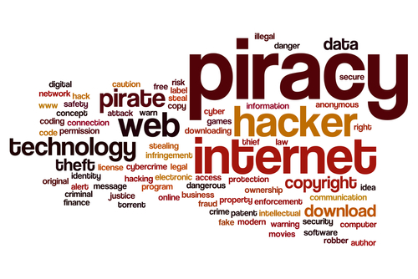
Digital Law
http://huntertafe.libguides.com

Slide 12
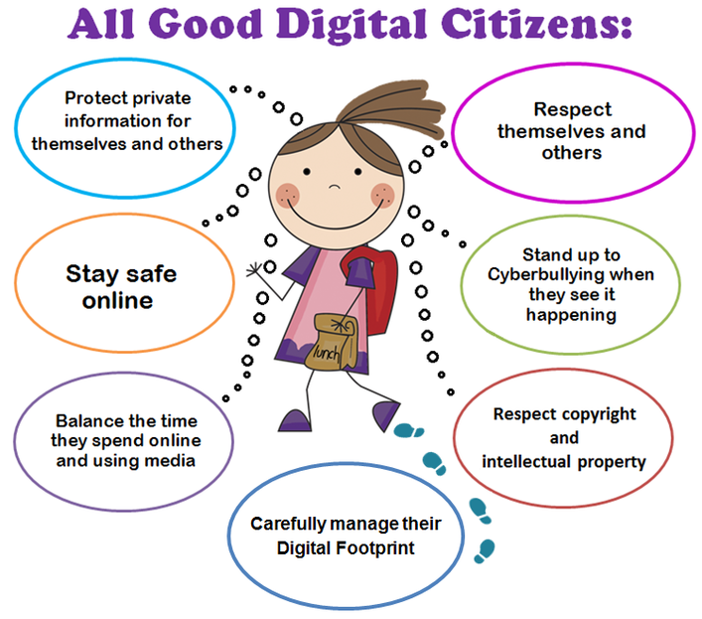
1
Virtuallibrary.info

Slide 13
Thank you very much for listening!

